Slide 1
Patient and Physician Reports: Data Visualization Plan
Timothy Daskivich, MD
Sept 4, 2025

Slide 2
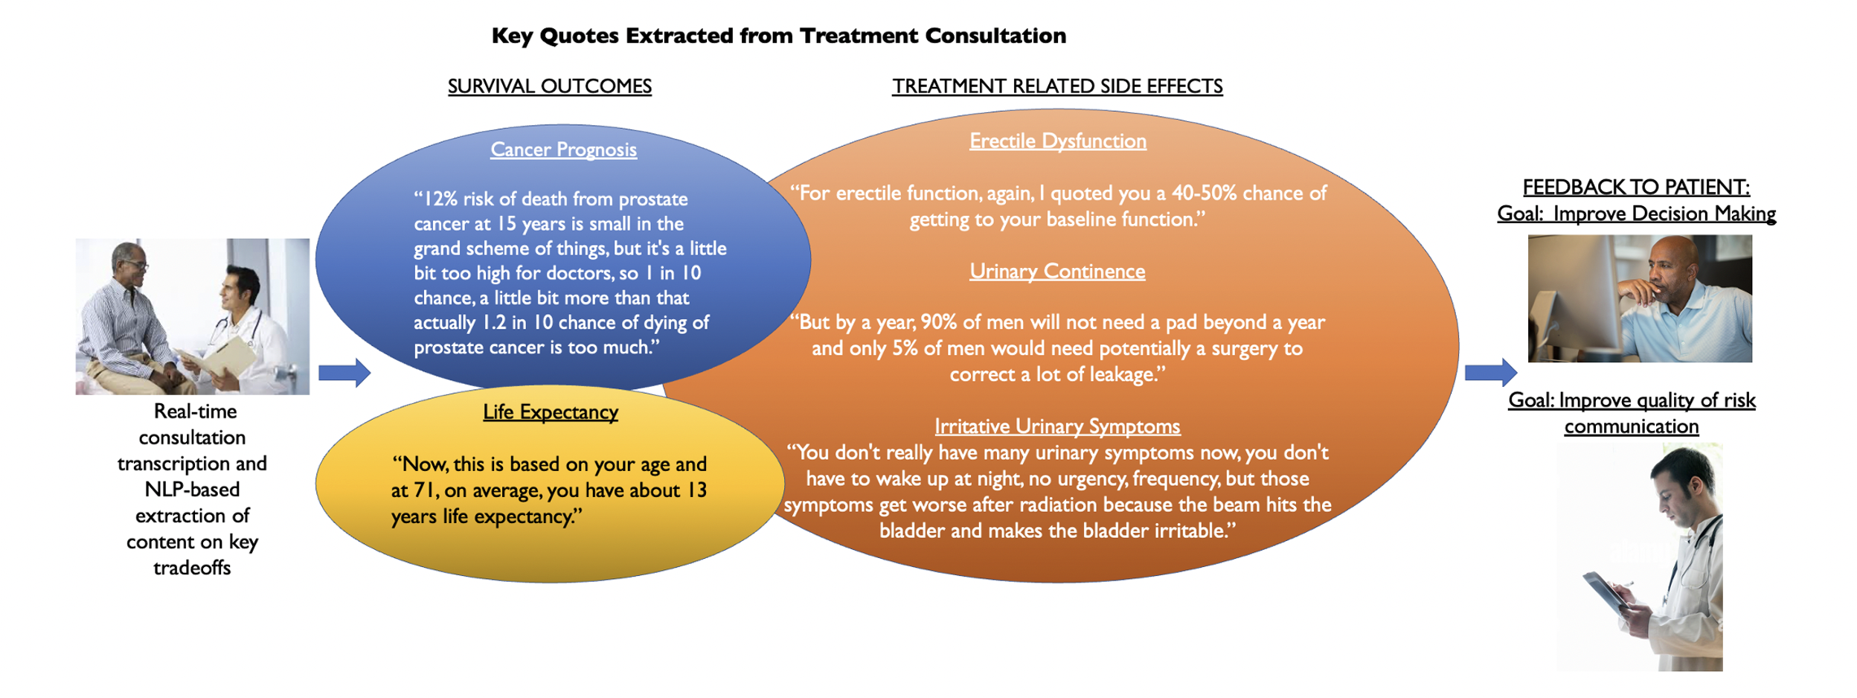
Cluster Randomized Trial of NLP+AI-Based Feedback from Prostate Cancer Consultations
Cluster randomized at level of physician to:
NLP+AI summaries of key topics emailed after the visit
Standard of care (AUA-published literature on risk communication (doctors) and decision making (pts)
Can real-time NLP+AI-based feedback on what was said in prostate cancer consultations improve quality of physician communication and patient decision making?
R01CA290559, PI: Daskivich

Slide 3
Patient Reports

Slide 4
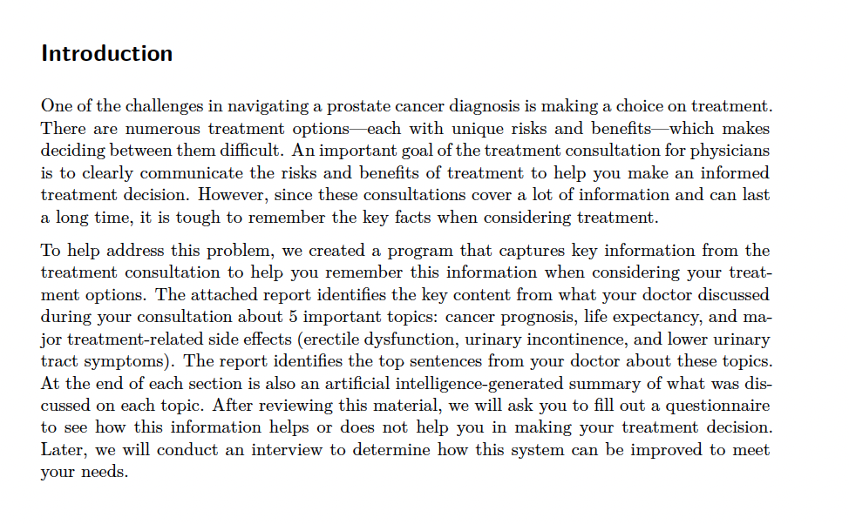

Slide 5
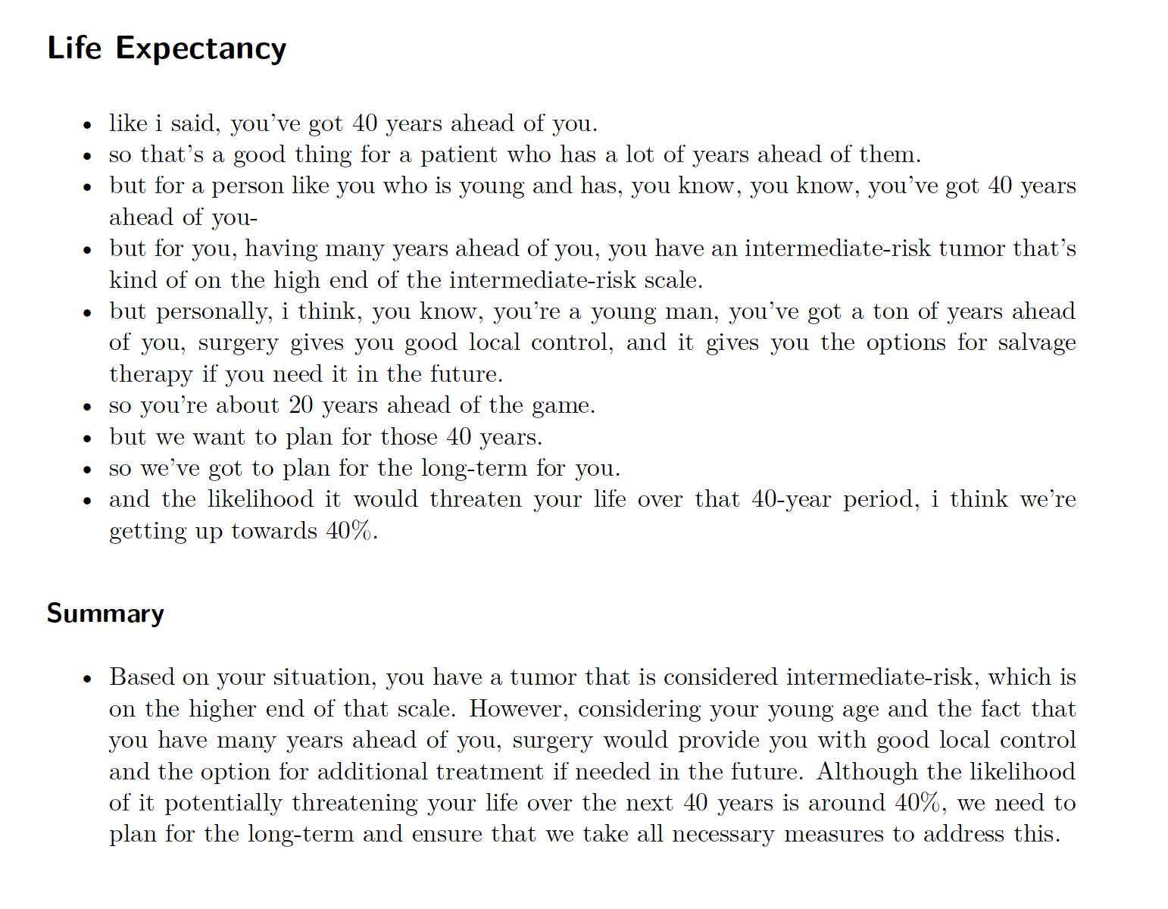

Slide 6
Patient Report
Introductory information explaining what results are (ie slide 4)
For each of 5 domains (cancer prognosis, life expectancy, erectile dysfunction, urinary incontinence, and irritative lower urinary tract symptoms):
Top 5 sentences extracted by NLP
AI summary (will send scripts and prompts for this)

Slide 7
Physician Reports

Slide 8
Physician Report
One page summarizing results in grid format (ie slide 9)
For each of 5 domains (cancer prognosis, life expectancy, erectile dysfunction, urinary incontinence, and irritative lower urinary tract symptoms) a separate “page” showing a display like slide 10.
However, the group felt like the x and y axes in the figure should be switched, making each level of quality vertical, with highest level on top
Suggestions for improvement (specific to each domain) are on slides 11-16
Only display suggestions for improvement that are higher than the scored sentence (ie if score was 3, only show suggestions to achieve score of 4 and 5)
Also would want the capability for doctors to provide a new sentence that would then be graded again by our AI scoring – could be verbal or type written

Slide 9
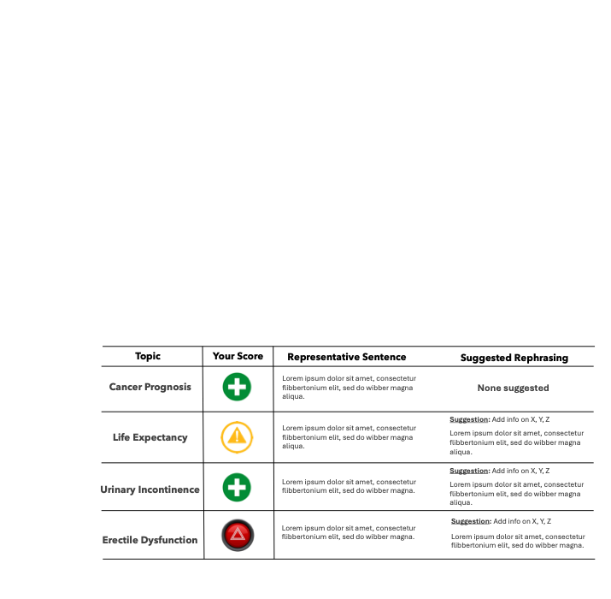
Grid summary
Score should be color coded and numeric 1 red 2 pink 3 yellow 4 ?light green 5 green; symbols unnecessary – should be colors and numbers
This should also have an additional column for suggestions for improvement in between the third and fourth column

Slide 10
Consultation Scoring: 3 (Imprecise Quantification)
Suggestions for Improvement
AI Re-write
“So 12% risk of death from prostate cancer at 15 years is small in the grand scheme of things but it’s a little but too high for doctors. 1 in 10 chance of dying of prostate cancer, is too much.”
Provide cancer prognosis with and without treatment (to achieve score of 4)
Provide cancer prognosis at life expectancy (to achieve score of 5)
“So 12% of risk of death from prostate cancer at your life expectancy of 17 years is a little too high. Treatment will reduce that risk to 6%.”
Cancer Prognosis
0
No mention
1
Name Only
2
Generalization
(”High”/”Low”)
3
Imprecise Quantification
4
Specific Quantification
5
Patient-centered Estimate
Quality of Risk Communication
“I hope you're not going to die of your cancer, I want to prevent that. So of course everyone who gets diagnosed with cancer wants to know what is the risk that the cancer will harm them. We know this data from studies looking at risk of cancer death in men who chose not to treat their cancers. In your case, that risk turns out to be 12% at 15 years. So 12% risk of death from prostate cancer at 15 years is small in the grand scheme of things, but it's a little bit too high for doctors, so 1 in 10 chance, a little bit more than that actually 1.2 in 10 chance of dying of prostate cancer is too much. So how do we get that number lower? We would treat with surgery or radiation. But would it be unreasonable to just watch this? Not totally. It's still on the table that you could potentially just watch this, but it's a value judgment, and we could match kind of what you think is important with your goals. But for the majority of these unfavorable risks, intermediate risk prostate cancer that I do recommend treatment, just to be on the safe side.”
Full Context

Slide 11
Suggestions for Improvement

Slide 12
Suggestions for Improvement: Cancer Prognosis
Discuss potential for risk of cancer death, metastasis, or progression (to achieve score of 1)
Provide a generalization of magnitude of risk (“high”/”low”) (to achieve a score of 2)
Provide a quantified estimate of risk (to achieve a score of 3)
Provide a quantified estimate of risk both with treatment and without treatment at an arbitrary timepoint (to achieve score of 4)
Provide a quantified estimates of risk both with and without treatment at the patient’s life expectancy (to achieve score of 5)

Slide 13
Suggestions for Improvement: Life Expectancy
Discuss the concept of competing risks of mortality (to achieve score of 1)
Provide a generalization of duration of life expectancy (i.e., “long”/”short”) (to achieve a score of 2)
Provide a rough quantified estimate of life expectancy (e.g., “about 15-20 years”) (to achieve a score of 3)
Provide a probability of living to an arbitrary timepoint (to achieve score of 4)
Provide a specific number of years and mention calculation based on the patient’s age and health status (to achieve score of 5)

Slide 14
Suggestions for Improvement: Erectile Dysfunction
Discuss the potential risk of erectile dysfunction (to achieve score of 1)
Provide a generalization of risk (i.e., “high”/”low”) (to achieve a score of 2)
Provide an average probability of ED without a time horizon (e.g., “45% risk of erectile dysfunction”) (to achieve a score of 3)
Provide an average probability of ED with a time horizon (e.g., “45% risk of erectile dysfunction at 1 year postop”) (to achieve a score of 4)
Provide a patient-specific probability of ED with a time horizon, mentioning patient-specific factors such as age and baseline function that inform your estimate (to achieve score of 5)

Slide 15
Suggestions for Improvement: Urinary Incontinence
Discuss the potential risk of urinary incontinence (to achieve score of 1)
Provide a generalization of risk (i.e., “high”/”low”) (to achieve a score of 2)
Provide an average probability of UI without a time horizon (e.g., “10% risk of needing pads”) (to achieve a score of 3)
Provide an average probability of UI with a time horizon (e.g., “10% risk of needing pads beyond 1 year postop”) (to achieve a score of 4)
Provide a patient-specific probability of UI with a time horizon, mentioning patient-specific factors such as age and baseline function that inform your estimate (to achieve score of 5)

Slide 16
Suggestions for Improvement: Irritative Urinary Symptoms
Discuss the potential risk of irritative urinary symptoms (to achieve score of 1)
Provide a generalization of risk (i.e., “high”/”low”) (to achieve a score of 2)
Provide an average probability of LUTS without a time horizon (e.g., “30% risk of developing irritative urinary symptoms”) (to achieve a score of 3)
Provide an average probability of LUTS with a time horizon (e.g., “30% risk of developing irritative urinary symptoms that may or may not resolve over the following year”) (to achieve a score of 4)
Provide a patient-specific probability of LUTS with a time horizon, mentioning patient-specific factors such as age and baseline function that inform your estimate (to achieve score of 5)

